Slide 1
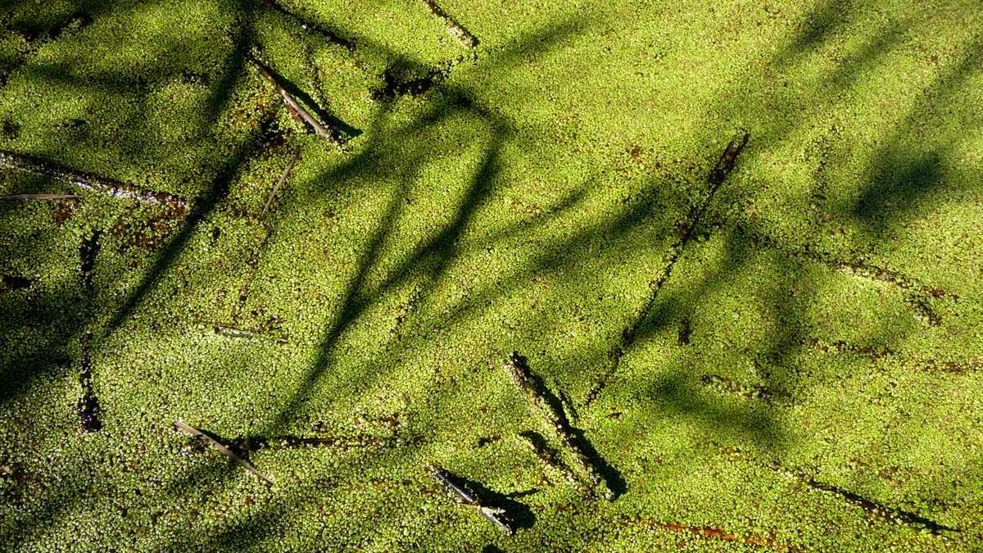
Seasonal Microbe Effects on Duckweed
Emma Kinerson
This Photo by Unknown Author is licensed under CC BY-NC

Slide 2
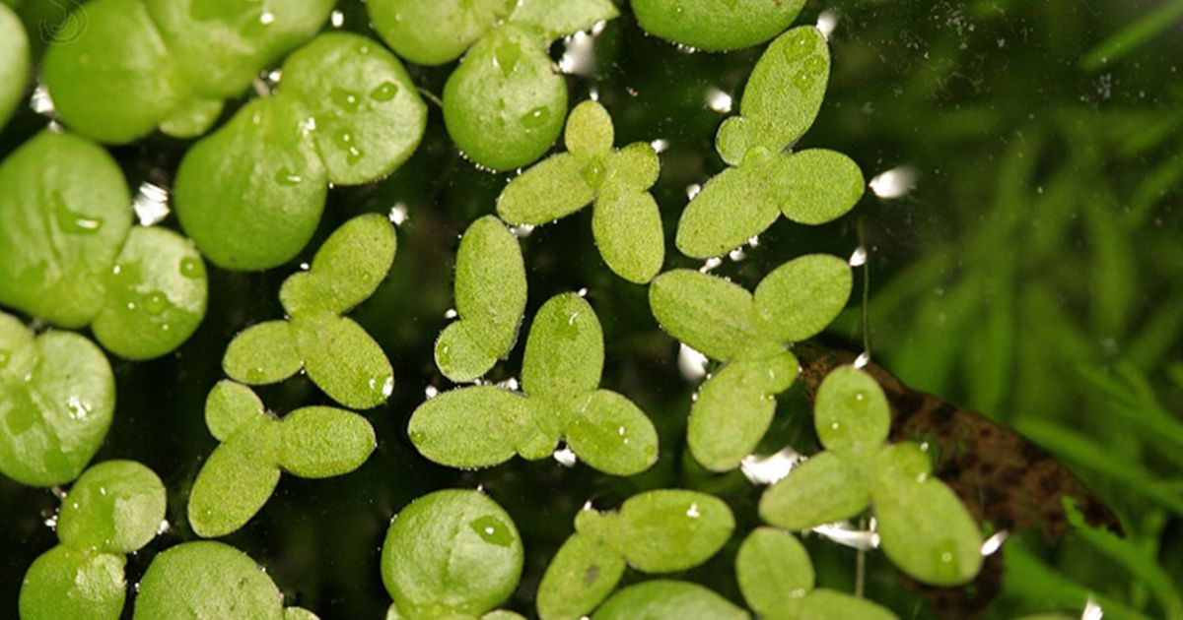
Background
Duckweed:
-small aquatic plant
-simple microbiome compared to terrestrial plants
-quick growth rate
This Photo by Unknown Author is licensed under CC BY

Slide 3
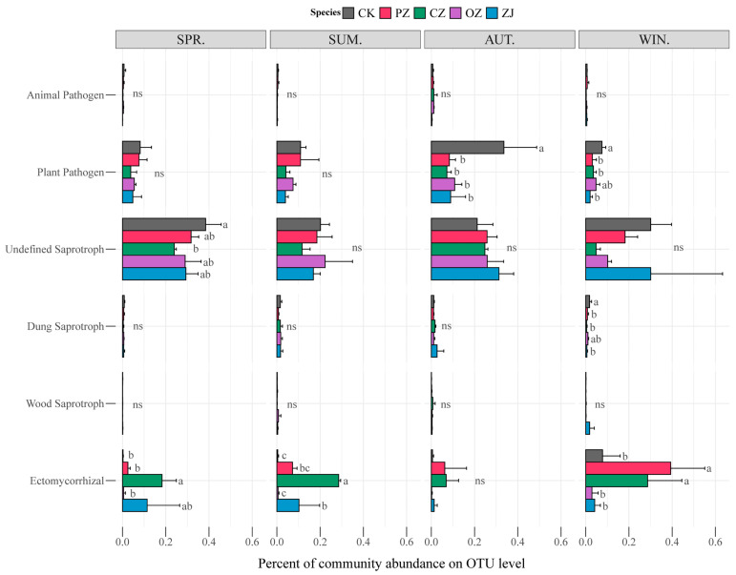
Background
Seasonal changes have been previously found to impact microbial community composition (Ma et al., (2021)).

Slide 4
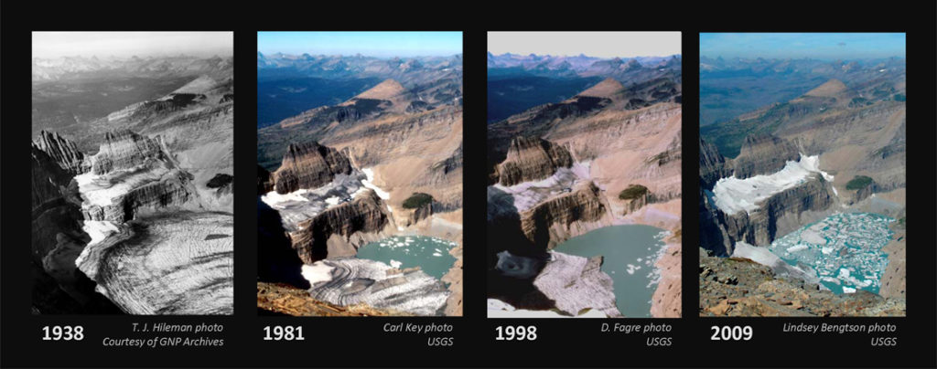
Background
Climate change:
-causing the earth to warm significantly over the past couple years
-threatens ecosystems and the natural diversity of our planet
This Photo by Unknown Author is licensed under CC BY

Slide 5
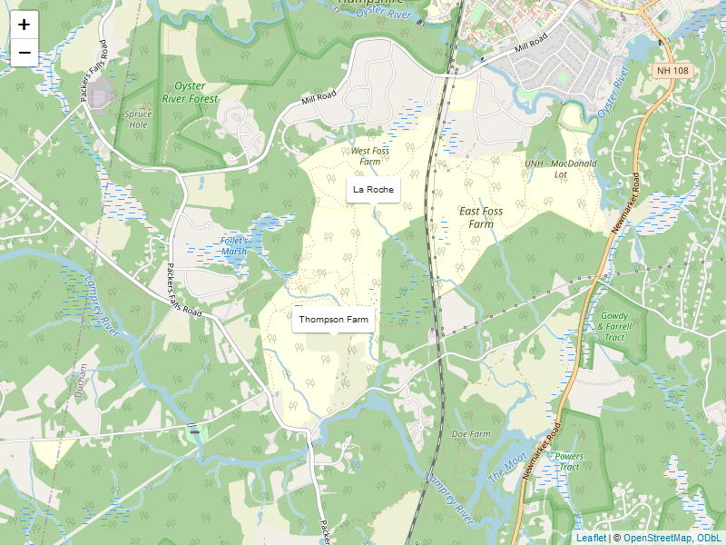
Methods
Microbes were sampled from two different locations across all four seasons.
Sterile duckweed were grown from plants taken at each location.
Microbes were isolated from crushed up duckweed tissue.
Well plates containing sterile duckweed were inoculated with treatments comprised of the seasonal microbes
Post experiment, media from each well containing the microbes were tested for optical density.

Slide 6
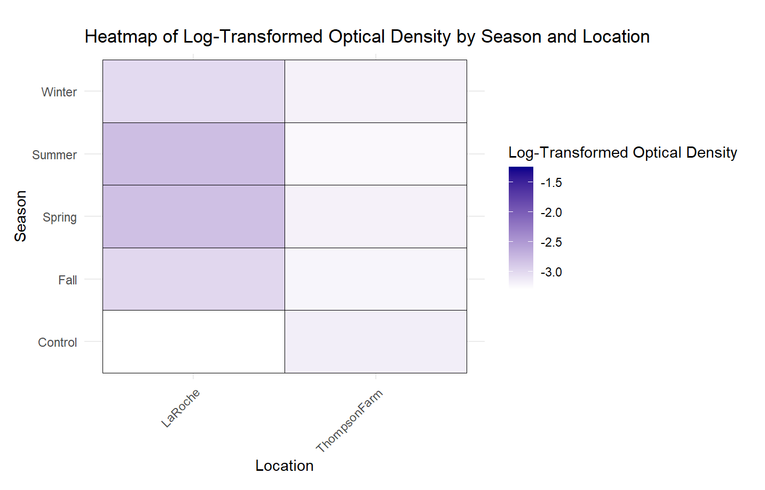
Results

Slide 7
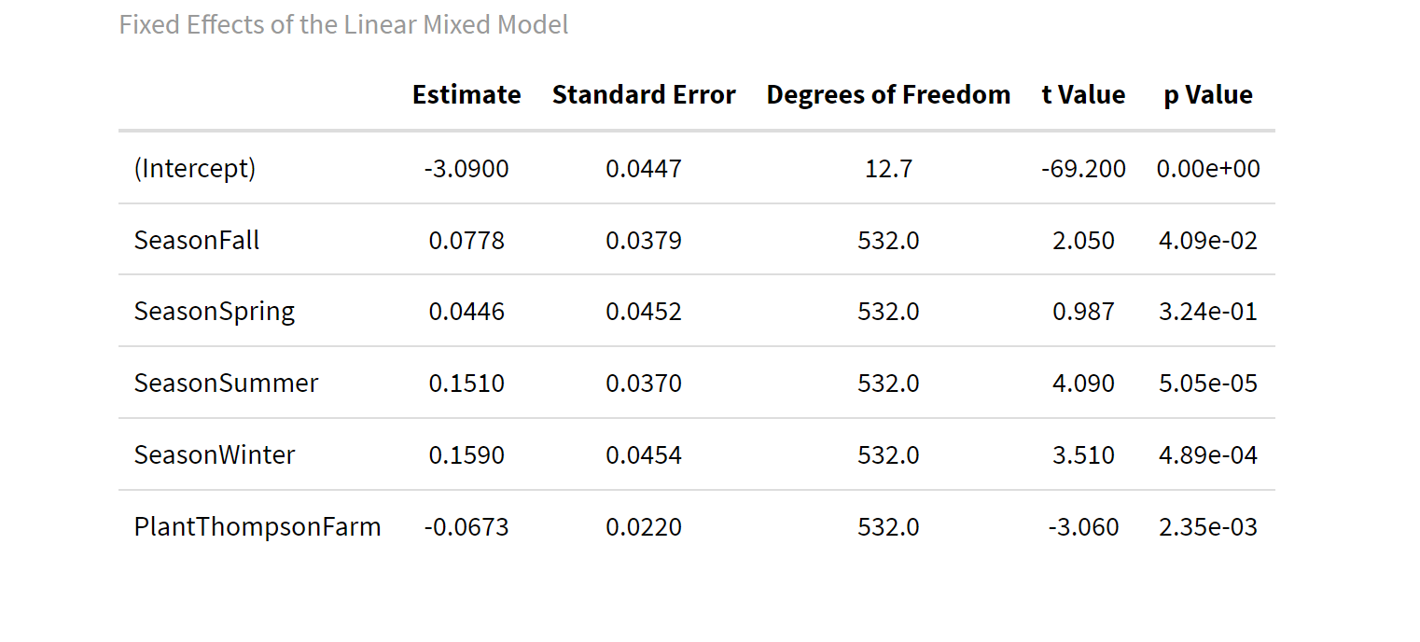
Results

Slide 8
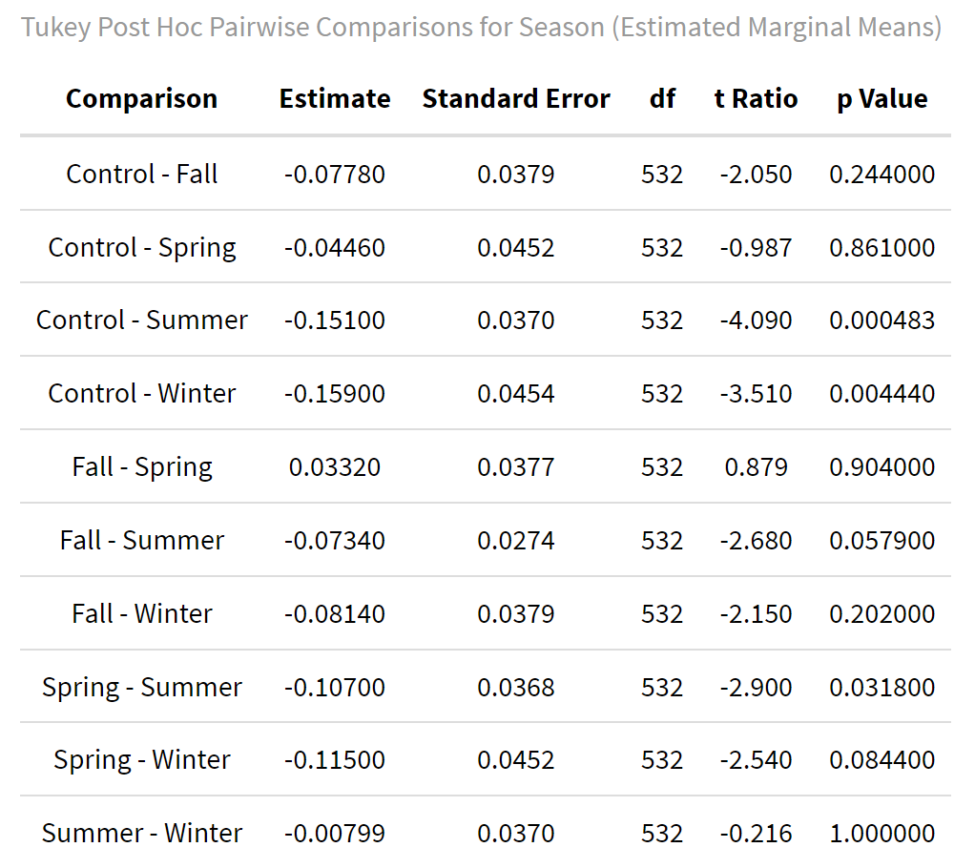

Results

Slide 9
Conclusion
OD600 was used for analysis.
Seasonal variation does influence function of microbial communities.
The largest limitation of this study was slight non-normality which could have impacted robustness of statistical tests.
Further analysis will be conducted on data to examine relationship between seasonal microbes and their effect on duckweed growth.
This study contributes to understanding the role of environmental factors on microbial communities and, in turn, their effects on plant growth.

Slide 10
References
Ma, Wenxu, Zhen Yang, Lisong Liang, Qinghua Ma, Guixi Wang, and Tiantian Zhao. 2021. “Seasonal Changes in Soil Microbial Community and Co-Occurrence Network of Species of the Genus Corylus.” Microorganisms 9 (11): 2228. https://doi.org/10. 3390/microorganisms9112228.
Mira, Portia, Pamela Yeh, and Barry G. Hall. 2022. “Estimating Microbial Population Data from Optical Density.” PLOS ONE 17 (10): e0276040. https://doi.org/10. 1371/journal.pone.0276040.
O’Brien, Anna M., Jason Laurich, Emma Lash, and Megan E. Frederickson. 2020. “Mutualistic Outcomes Across Plant Populations, Microbes, and Environments in the Duckweed Lemna Minor.” Microbial Ecology 80 (2): 384–97. https://doi.org/10. 1007/s00248-019-01452-1.
Ruan, Yang, Yakov Kuzyakov, Xiaoyu Liu, Xuhui Zhang, Qicheng Xu, Junjie Guo, Shiwei Guo, Qirong Shen, Yunfeng Yang, and Ning Ling. 2023. “Elevated Temperature and CO2 Strongly Affect the Growth Strategies of Soil Bacteria.” Nature Communications 14 (1): 391. https://doi.org/10.1038/s41467-023-36086-y.
Santoyo, Gustavo, Carlos Alberto Urtis-Flores, Pedro Damián Loeza-Lara, Ma Del Carmen Orozco-Mosqueda, and Bernard R. Glick. 2021. “Rhizosphere Colonization Determinants by Plant Growth-Promoting Rhizobacteria (PGPR).” Biology 10 (6): 475. https://doi.org/10.3390/biology10060475.
Thingujam, Doni, Karolina M. Pajerowska-Mukhtar, and M. Shahid Mukhtar. 2024. “Duckweed: Beyond an Efficient Plant Model System.” Biomolecules 14 (6): 628. https://doi.org/10.3390/biom14060628.

